Slide 1




ASM
Calculator
-Addition
-Subtraction
MunYoung Cho
Yongeun Kwon
Ebod Shojaei
COMP2721

Slide 2

Overview
What is ASM?
Calculator - Additon
Calculator - Subtraction
Q&A

Slide 3


CPU Architecture
intel x86
what is ASM?
Hardware
Centric
Assembly Laguage / Low level language
: It provides a direct interface between software and hardware, translating human-readable code into machine code.
Instructions
e.g. mov, add, sub
Registers
e.g. EAX, EBX, ECX
Memory Management

Slide 4
NASM is a line-based assembly program
A NASM can be broken down into three sections:
data section: used for declaring static variables (do not change at runtime)
bss section: used for declaring dynamic variables (do change at runtime)
text section: used for containing the actual logic of the program
Syntax

Slide 5


ASM
better performance
optimization possibilities
deep understanding of how software and hardware interact
Complex
architecture-dependent
more prone to errors
Advantages
Limitation

Slide 6
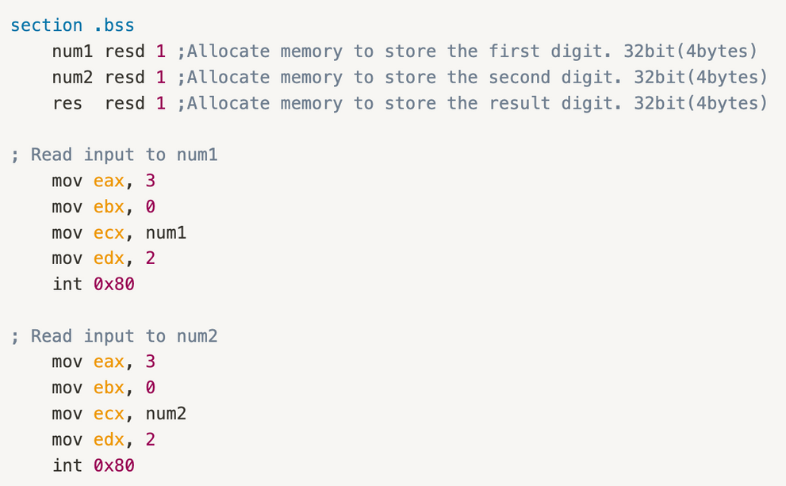
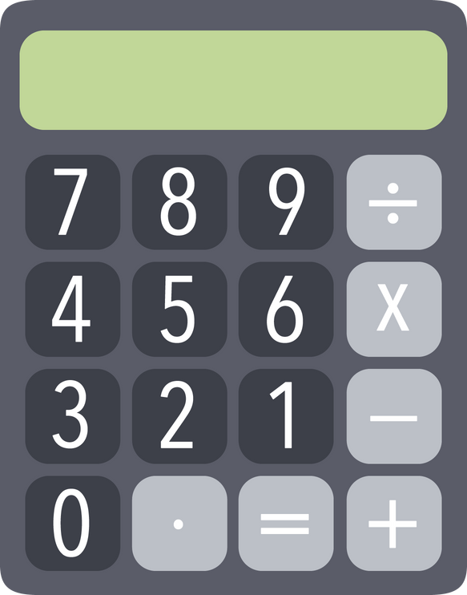
Our Team’s ASM
Calculator - Read input values

Slide 7
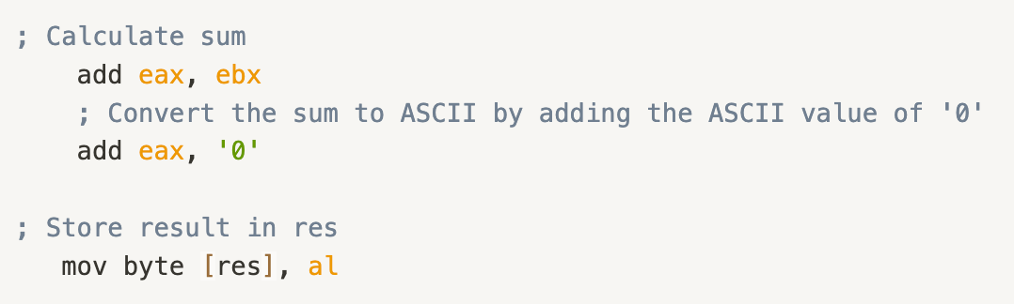
Our Team’s ASM
Calculator - Addtion
Addition

Slide 8
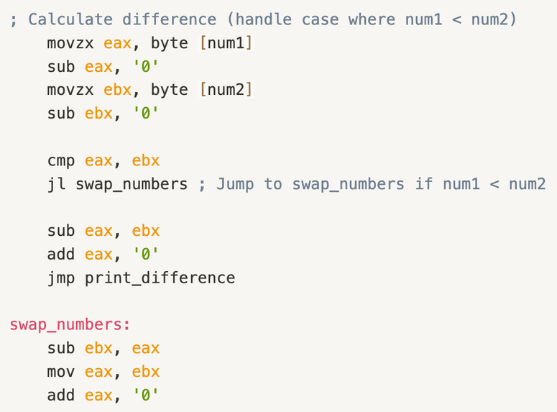
Our Team’s ASM
Calculator - Addtion/Subtraction
Subtraction

Slide 9


Q&A
THANK YOU
Calle Cualquiera 123, Cualquier Lugar

